Slide 1
Florida KidCare: Health and Dental Insurance for Kids

Slide 2
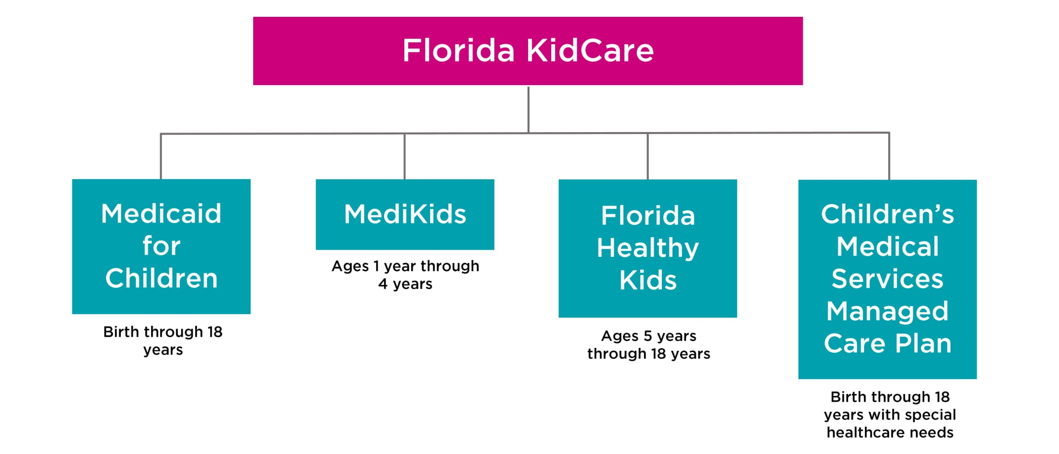
Florida KidCare Programs
Florida KidCare is the state of Florida’s affordable, high quality health and dental insurance program for kids.

Slide 3
Florida KidCare Programs
Medicaid for Children:
Children from birth through the end of age 18
Families pay nothing for coverage (applies to all children in the family)
Administered by the Agency for Health Care Administration (AHCA)
Eligibility determined by the Department of Children & Families (DCF)
Parents need to meet low-income eligibility requirement (up to 133% of the Federal Poverty Level (FPL))
***Parent or caretaker’s citizenship does not impact eligibility***

Slide 4
Florida KidCare Programs
MediKids:
Children ages 1 to 4, not eligible for Medicaid
Administered by AHCA
Eligibility determined by Florida Healthy Kids Corporation
Most families pay $15 - $20/month for all children in family
Full-pay option available
Children enrolled in MediKids receive Medicaid benefits and medical services from Medicaid providers
Income between 133%-200% FPL qualify for subsidized coverage and 200%+ FPL qualify for full-pay coverage

Slide 5
Florida KidCare Programs
Florida Healthy Kids:
Children ages 5 through the end of age 18, not eligible for Medicaid
Administered and eligibility determined by the Florida Healthy Kids Corporation
Most families pay $15 - $20/month for all children in family
Full-pay option available
Income between 133%-200% FPL qualify for subsidized coverage
Income at 200%+ FPL qualify for full-pay coverage

Slide 6
Florida KidCare Programs
Children’s Medical Services (CMS) Managed Care Plan:
Children from birth through the end of age 18 with special medical conditions
Administered and clinical eligibility determined by Department of Health
Families pay $15 or $20/month for all children in family
Income between 133%-200% FPL qualify for this subsidized coverage
Special network of physicians and providers. Full range of care: prevention, early intervention, primary & specialty care, etc.

Slide 7
Children’s Health Insurance in Florida
Currently, the highest number of Florida’s uninsured children live in just five counties:
Broward – 33,705
Hillsborough – 16,792
Miami-Dade – 43,952
Orange – 17,061
Palm Beach – 20,042
*Data for Children’s Health Insurance Program (MediKids, Florida Healthy Kids, Children’s Medical Services Managed Care Plan (excludes Medicaid) -- as of September 2019

Slide 8
Example of Benefits Covered:
Mental Health Services
Doctor
Visits
Vision & Hearing
Dental
Check-ups
& Shots
Prescriptions
Emergencies
Surgeries

Slide 9
Eligibility
Eligibility is based on household size, income and age of the child.
To qualify for low-cost Florida KidCare coverage, a child must:
Be under age 19
Be a Florida resident
Be a U.S. citizen or lawfully residing immigrant
Not reside in a public institution
Meet income eligibility requirements

Slide 10
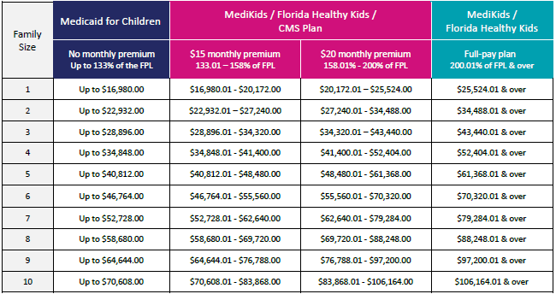
Eligibility
These annual income guidelines are for informational purposes only. Florida KidCare eligibility depends on other factors beyond a family’s annual income. The Federal Poverty Guidelines are published by the Department of Health and Human Services, effective April 2020.

Slide 11
Eligibility
MediKids Full-Pay
$157 monthly premium /child
Florida Healthy Kids Full-Pay
$230 monthly premium with dental / child
200%
MediKids
$15 or $20 monthly premium
Florida Healthy Kids
$15 or $20 monthly family premium
133%
Federal Poverty Level**
Medicaid for Children
No monthly premium
Ages 0 to 1
Ages 1 through 4
Ages 5 through 18
CMS Plan*
*133% to 200% of the FPL have $15 or $20 monthly premiums.
**For a family of four, 133% of the FPL’s annual income is $34,848, and 200% is $52,404 as of April 2020.

Slide 12
Eligibility Calculator
Families can use the eligibility calculator to estimate their monthly premium payment through two steps:
Entering the number of people in their family
Entering their annual household income

Slide 13
Eligibility Calculator
Available on the FloridaKidCare.org website
in Spanish and Haitian Creole

Slide 14
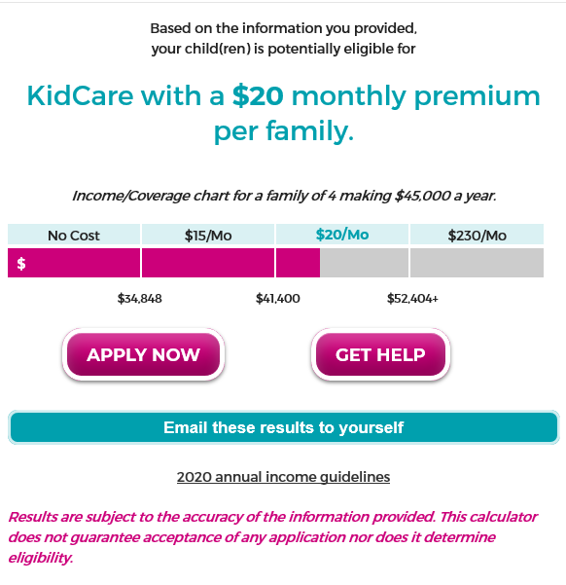
Eligibility Calculator
Sample Result: 4 people in the family with a total annual household income of $45,000 pay a $20 monthly premium for all children in the home.

Slide 15
Full-Pay Options
Non-subsidized coverage is available through MediKids and Florida Healthy Kids.
MediKids $157 per month per child with dental
(ages 1 through the end of 4)
Florida Healthy Kids $230 per month per child with dental
(ages 5 through the end of 18) $215 per month per child without dental

Slide 16
Healthy Kids Full-Pay Plan Changes Effective January 1, 2020
Applies only to the Florida Healthy Kids full-pay plan for children aged five through the end of age 18
Full-pay plan is available to families earning 200% + of the federal poverty level (Ex. $51,500 for family of 4)
- There is no cut-off or threshold for families who earn more, even if they work
- Employer-sponsored coverage may be too expensive – this can be a more affordable option

Slide 17
Healthy Kids Full-Pay Plan Changes Effective January 1, 2020
Per Child Medical Deductible:
From $3,000 to $0
Per Child Pharmacy Deductible:
From $1,500 to $0
25% Coinsurance ELIMINATED
Copay Costs From $25-$40 to $5-$10

Slide 18
How Do Families Apply?
Enrollment is open year-round, so the time to apply is always now.
1. Go to
http://www.gadsdenschools.org
2. Scroll Down the Left side under Universal Links
3. Select KidCare Application
Fill Out the Application!
When It Says How did you hear about us:
Insert “GC2”
**When filling out an application and they ask you how did you hear about us, Make sure to put GC2 in the box**.

Slide 19
CONTACT INFORMATION:
Elijah Israel Title I Program Assistant
Gadsden County School District
Israele@gcpsmail.com
(850)627-9651 (ext. 1300)

